Slide 1
Security Issues in Public Safety Communication
Kevin Kuo

Slide 2
Agenda
Background
Current State
Near Term State
Objective
Proposed Solution
Overview
Radio Access Network
Device
Application

Slide 3
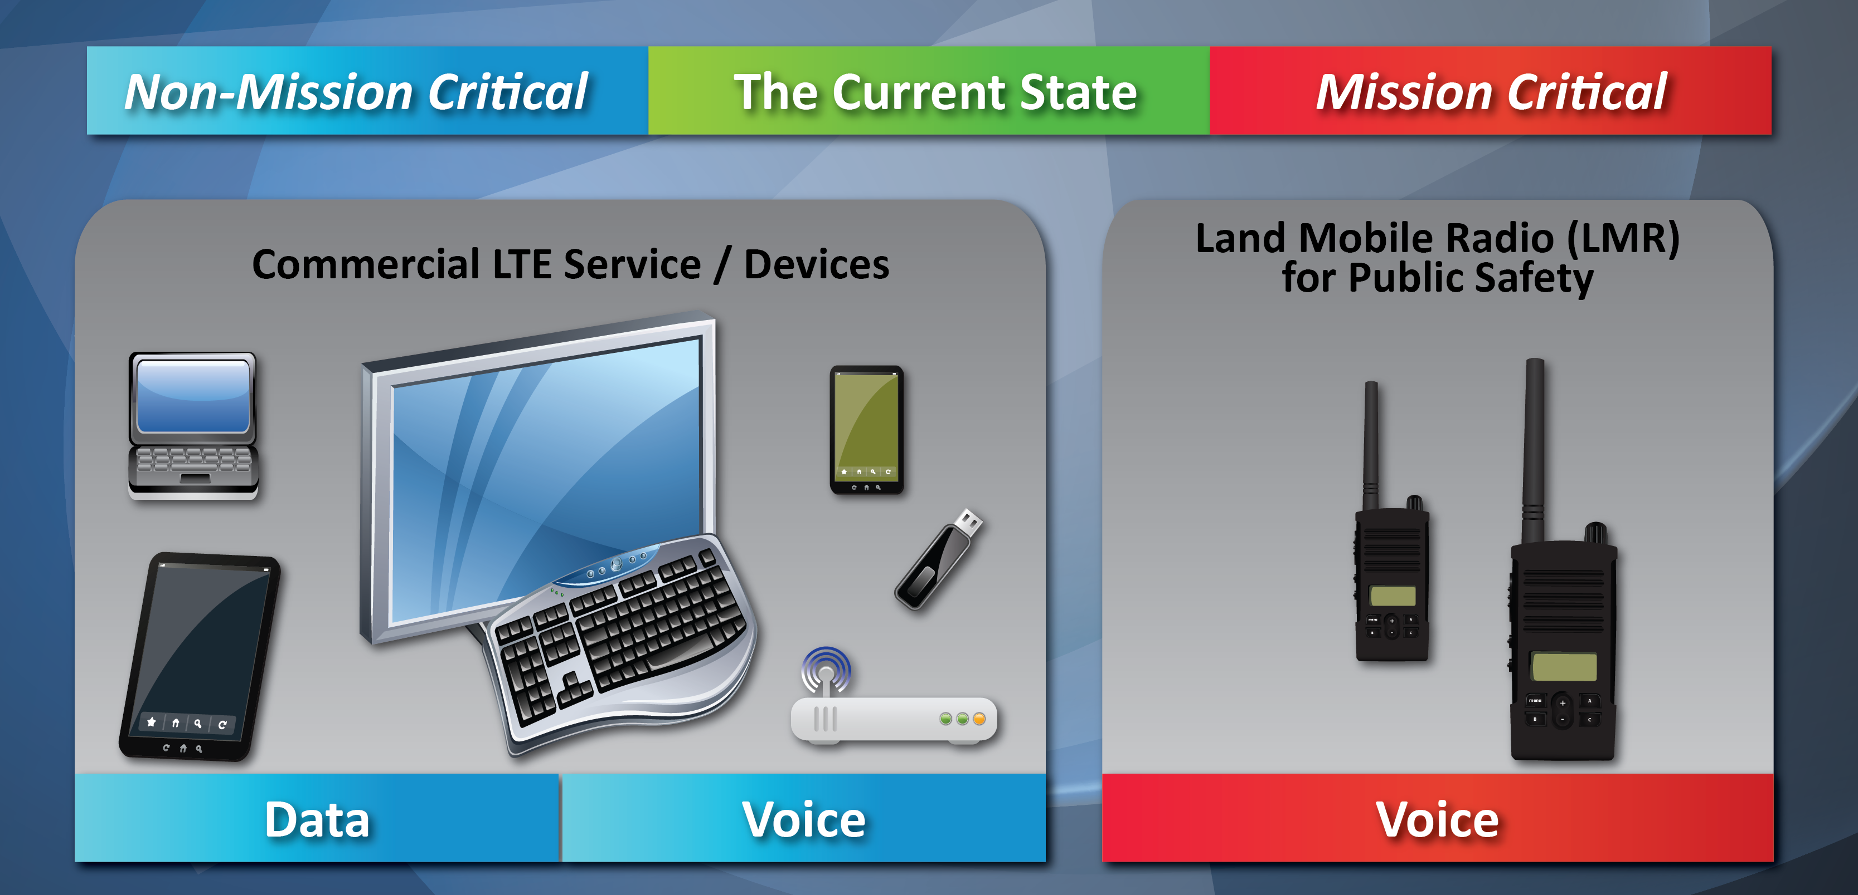
Background – Current State
Notes:
First responders recognized the necessity for public safety communication networks to evolve beyond mission-critical voice services to encompass providing mission critical data services.
Middle Class Tax Relief and Job Creation Act (MCTRJC) of 2012 required FirstNet, a government managed next generation public safety communication network initiative known as the First Responder Network Authority, to build, operate, and maintain the first high speed nationwide broadband network dedicated to public safety.
Demo - equipment

Slide 4
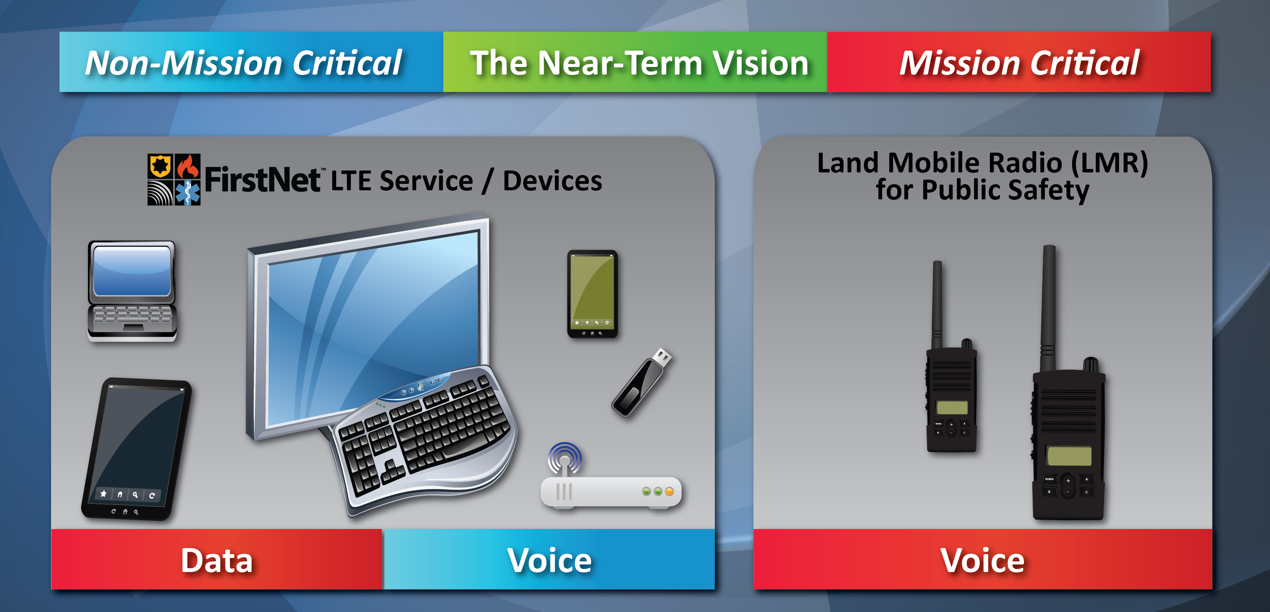
Background – Near Term State
Notes:
Objective of the network will be to provide mission critical, high speed data and video services that will supplement Land Mobile Radio networks which would provide mission critical voice services.

Slide 5
Objective
Propose ways in which FirstNet can protect and secure mission critical data that traverses its network.
Notes:
One important thing:
UNCLASSIFIED
FirstNet is designed to carry unclassified data.

Slide 6
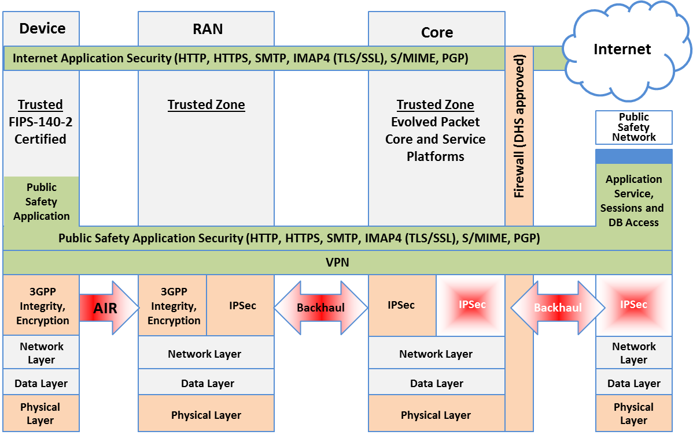
Proposed Solution - Overview
Notes:
Representative of the 7 layer Open System Interconnection model
Application
Presentation
Session (VPN)
Transport (IPsec)
Network
Data Link
Physical

Slide 7
Proposed Solution – Radio Access Network
Threats
Insider attacks
External attacks from other networks (Internet)
External attacks on physical access to the network on radio interfaces
Attacks from other devices
IPsec (IP Security)
Open standards framework to help ensure private, secure communications over IP protocol through cryptographic services
Authentication and encryption between towers and core network
Protect integrity of user traffic and network

Slide 8
Proposed Solution – Device
Device to Network
UICC – SIM Card
Hardware storage location for sensitive information such as a pre-shared key and IMSI
IMSI is unique to every subscriber (device)
FirstNet will not grant access to anything other than a LTE SIM card
User of Device
2 layers of authentication to access mission critical data
First layer to access basic features of device
Second layer to access mission critical data with VPN support
Example: Samsung KNOX
Notes:
Different than a commercial mobile carrier which has to consider backwards compatibility with 2G and 3G devices
Demo – cell phone

Slide 9
Proposed Solution – Application
Approved applications
Enterprise management of permissible applications
Sensitive applications require additional application specific login credentials
HTTPS
TLS
S/MIME
Notes:
Hyper Text Transfer Protocol Secure (HTTPS) is the secure version of HTTP, the protocol over which data is sent between your browser and the website that you are connected to. The 'S' at the end of HTTPS stands for 'Secure'. It means all communications between your browser and the website are encrypted. HTTPS is often used to protect highly confidential online transactions like online banking and online shopping order forms.
TLS (Transport Layer Security) and SSL (Secure Sockets Layer) are protocols that provide data encryption and authentication between applications and servers in scenarios where that data is being sent across an insecure network, such as checking your email (How does the Secure Socket Layer work?). The terms SSL and TLS are often used interchangeably or in conjunction with each other (TLS/SSL), but one is in fact the predecessor of the other — SSL 3.0 served as the basis for TLS 1.0 which, as a result, is sometimes referred to as SSL 3.1. With this said though, is there actually a practical difference between the two?

Slide 10
Conclusion
Very secure for Unclassified For Official Use Only data
Not 100% secure against State/Government actors
Most challenging part is in implementation
Transitioning from commercial network to public safety network, FirstNet

Slide 11
Questions?

Slide 12
Survey - Wireless Network Security
Kevin Kuo

Slide 13
Overview
Open WiFi
WEP
Cracking WEP
WPA
Cracking WPA (Dictionary based attack)
WPA2
Home use – shared key
WPA Enterprise (aka 802.11x)

